Slide 1
IFS
Few IFS and Their Parameters

Slide 2
Steps
Fill In Parameter Table. Change “randdata” according to probability if required. If probability is not mentioned, play around with probability and see which gives nice images.
Declare variables
i<- rand(1,2,….n), where n is the number of transformations.
Do x = Ai x+ bi
Mark a point at x
Repeat 2,3,4,5 N times

Slide 3
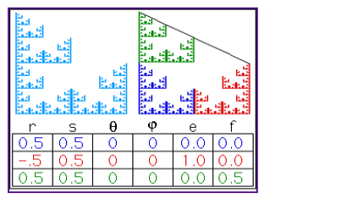
IFS-1

Slide 4
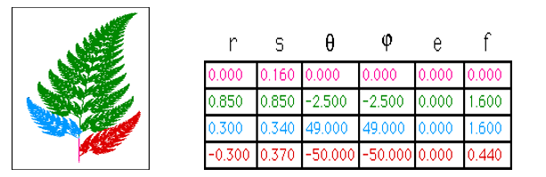
IFS-1

Slide 5
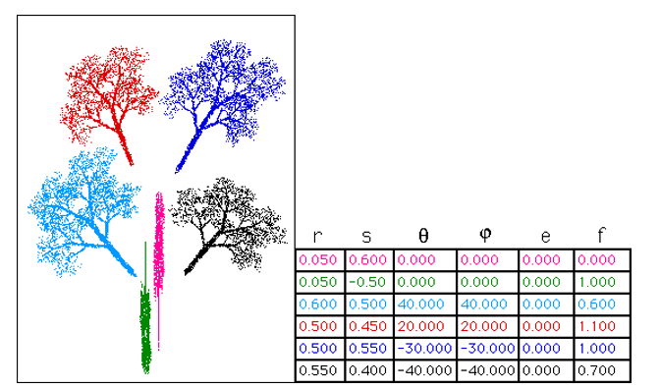
IFS-1

Slide 6
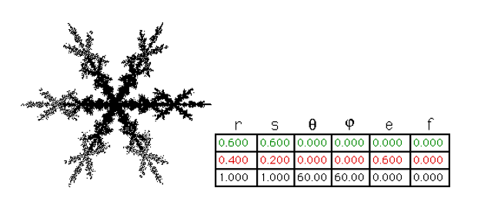
IFS-1

Slide 7
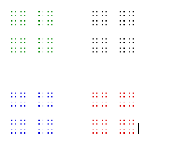
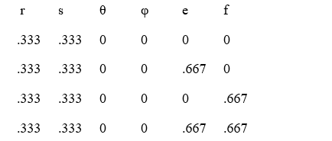
IFS-1

Slide 8
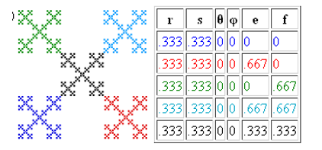
IFS-1

Slide 9
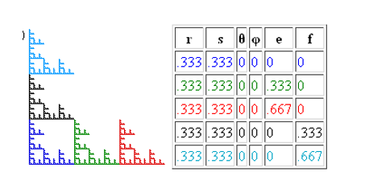
IFS-1

Slide 10
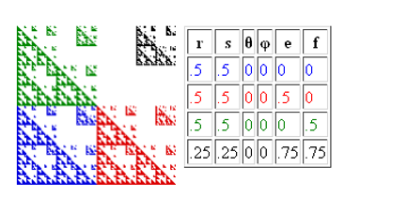
IFS-1

Slide 11
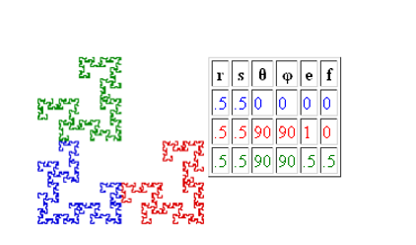
IFS-1

Slide 12
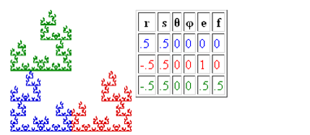
IFS-1

Slide 13
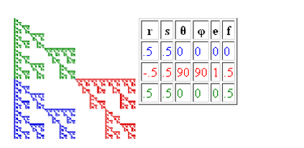
IFS-1

Slide 14
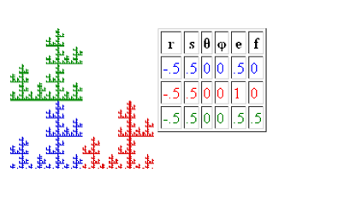
IFS-1

Slide 15
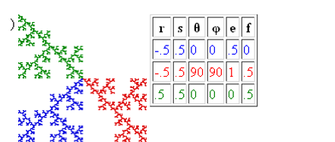
IFS-1

Slide 16
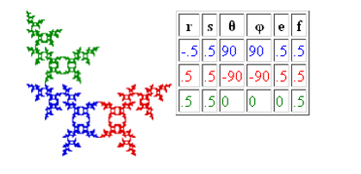
IFS-1

Slide 17
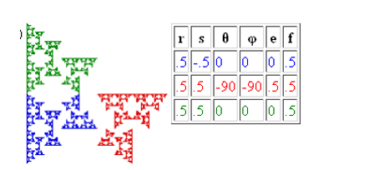
IFS-1

Slide 18
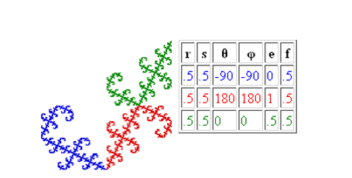
IFS-1

Slide 19
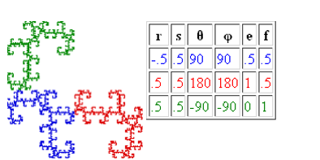
IFS-1

Slide 20
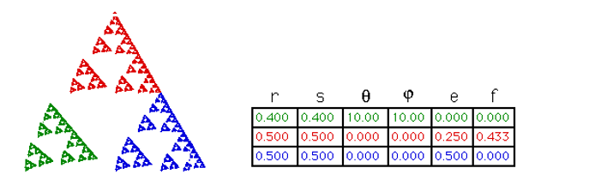
IFS-1

Slide 21
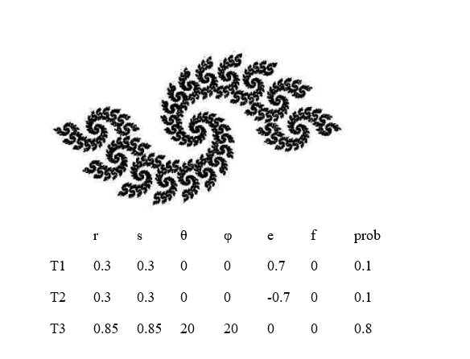
IFS-1

Slide 22
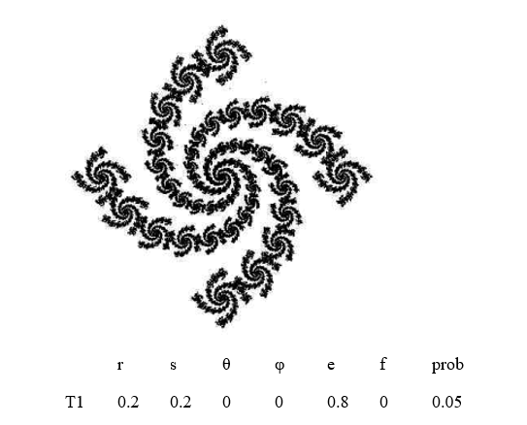
IFS-1

Slide 23
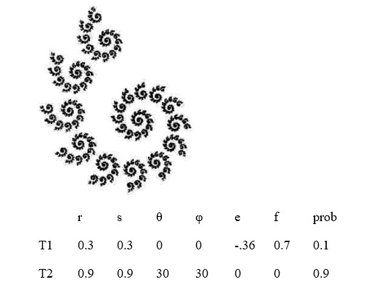
IFS-1

